Slide 1


Automatic Generation Image Captions based on Deep Learning and Neural Network
Vamshi Ponugoti – 700742855
Geeta Sree Doddapaneni -700744905
Naveena Tangella –700748201
Thoyaja kanala –700747744

Slide 2
Contribution:
Vamshi: Did research about the project and finalised it.studied about the current project and gathered required information to proceed. Finalised the dataset for the project.
Geeta Sree: Did research about the project and finalised it. Studied about the technical architecture of the project and created the architectural flow for the project.
Naveena: Did research about the project and studied how CNN model works and how to implement CNN.
Thoyoja: Did research about the project and researched about LSTM. Helped to implement LSTM in the project.

Slide 3
Motivation :
The goal of this project is to caption the images that displays in different sources like television ,news, internet and many more sources by using deep learning techniques.
However human are capable enough to interpret themselves without having a description whereas this is very tough for machine to interpret. Machines need description to understand.
In the era of artificial intelligence, captioning of a natural scene is a well-known research problem that helps to give a description of an image. language processing.

Slide 4
Objectives :
Image caption Generator is a popular research area of Artificial Intelligence that deals with image understanding and a language description for that image.
Being able to describe the content of an image using accurately formed sentences is a very challenging task, but it could also have a great impact, by helping visually impaired people better understand the content of images.

Slide 5
Related work :
Each member in the group had contributed the core content from the different papers.
The core contents included in the project are RNN ,LSTM,CNN.
RNN- We got this from the paper Face mask detection using deep neural networks.
LSTM – From the paper An Approach for Rainfall Prediction Using Long Short Term Memory Neural Network
CNN- This is from the paper Convolutional Neural Networks for image classification.

Slide 6
Problem Statement :
CNN-RNN framework based image captioning technique has two drawbacks in training phase. First drawback is each caption gets equal importance without their individual importance and second drawback is during caption generation objects may not be correctly recognized.
In this paper we have also suggested called Reference based long short term memory (R-LSTM) that main aim is by implementing reference information to give more descriptive caption for a query image.

Slide 7
Proposed Solution:
In order to caption natural scenes, image captioning research Kiros et al implemented this framework which is called encoder and decoder based to combined use image-text embedding model and multi-modal sentence generation models, for a query image, a description which is an output produced word by word similar to language translation.
For encoding textual data a special RNN they used called Long Short Term Memory (LSTM) and for encoding visual data a deep Convolutional neural network used. .

Slide 8
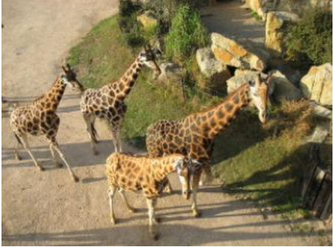
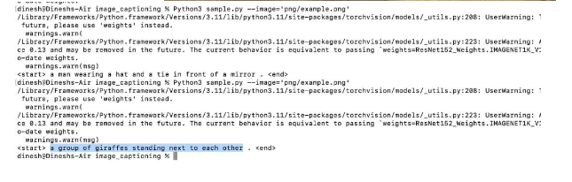
Results :

Slide 9
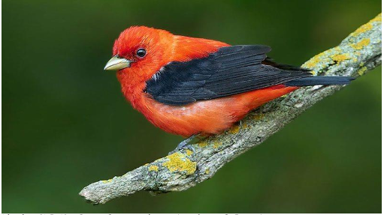
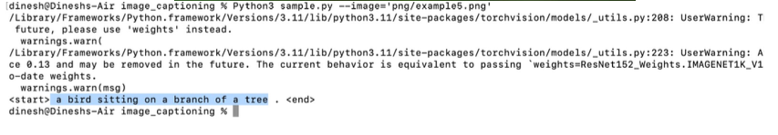

Slide 10
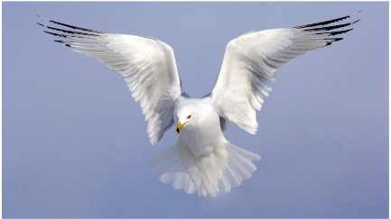
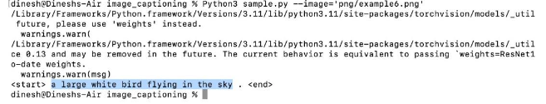

Slide 11

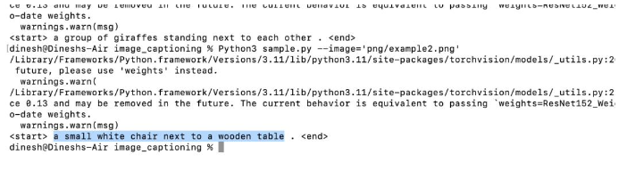

Slide 12
References:
1.Graves, A.; Liwicki, M.; Fernández, S.; Bertolami, R.; Bunke, H.; Schmidhuber, J. (May 2009). "A Novel Connectionist System for Unconstrained Handwriting Recognition". IEEE Transactions on Pattern Analysis and Machine Intelligence. 2. Li, Xiangang; Wu, Xihong (2014-10-15). "Constructing Long Short-Term Memory based Deep Recurrent Neural Networks for Large Vocabulary Speech Recognition 3. Wu, Yonghui; Schuster, Mike; Chen, Zhifeng; Le, Quoc V.; Norouzi, Mohammad; Macherey, Wolfgang; Krikun, Maxim; Cao, Yuan; Gao, Qin (2016-09-26). "Google's Neural Machine Translation System: Bridging the Gap between Human and Machine Translation 4. Mayer, H.; Gomez, F.; Wierstra, D.; Nagy, I.; Knoll, A.; Schmidhuber, J. (October 2006). A System for Robotic Heart Surgery that Learns to Tie Knots Using Recurrent Neural Networks. 2006 IEEE/RSJ International Conference on Intelligent Robots and Systems. pp. 543–548. 5. Rodriguez, Jesus (July 2, 2018). "The Science Behind OpenAI Five that just Produced One of the Greatest Breakthrough in the History of AI". Towards Data Science. Archived from the original on 2019-12-26. Retrieved 2019-01-15.

Slide 13
6. Li, Xiangang; Wu, Xihong (2014-10-15). "Constructing Long Short-Term Memory based Deep Recurrent Neural Networks for Large Vocabulary Speech Recognition 7. K. Cho, B. Van Merriënboer, Ç. Gülçehre, D. Bahdanau, F. Bougares, H. Schwenk, Y. Bengio, Learning phrase representations using rnn encoder–decoder for statistical machine translation, in: Proceedings of the 2014 Conference on Empir-ical Methods in Natural Language Processing (EMNLP), Association for Computational Linguistics, Doha, Qatar, 2014. 8. Rashtchian C, Young P, Hodosh M, Hockenmaier J. (2010) Collecting image annotations using Amazon’s Mechanical Turk. In: Proceedings of the NAACL HLT 2010 workshop on creating speech and language data with Amazon’s Mechanical Turk. Association for Computational Linguistics. 9. D. Lin, An information-theoretic definition of similarity, in: Proceedings of the Fifteenth International Conference on Machine Learning 10. Dewa Made Sri Arsa, I.P.A. Bayupati & Kadek Sastrawan ,” Detection of fake news using deep learning CNN–RNN based methods”

